Slide 1


Bexar County COVID-19 by the Numbers
Victor Baker
Maria Ramirez
Courtney Hyland

Slide 2
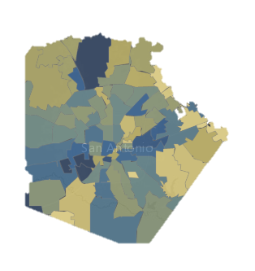
We wanted to know…
For each zip code in Bexar County vs COVID-19 did these factors play a role:
Median Income
Mean Age
Overall Ethnicity

Slide 3
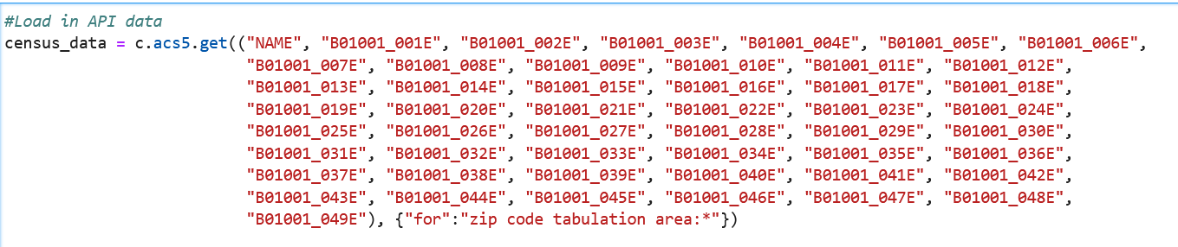
Data Sources
We obtained Bexar County COVID-19 data from the City of San Antonio.
This was compared with data obtained from the Census Bureau API
We removed zip codes 78150 JBSA

Slide 4
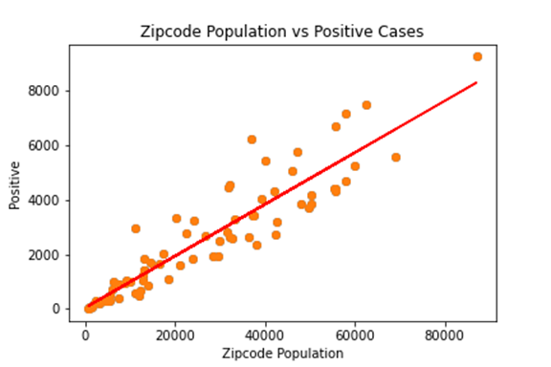

Slide 5
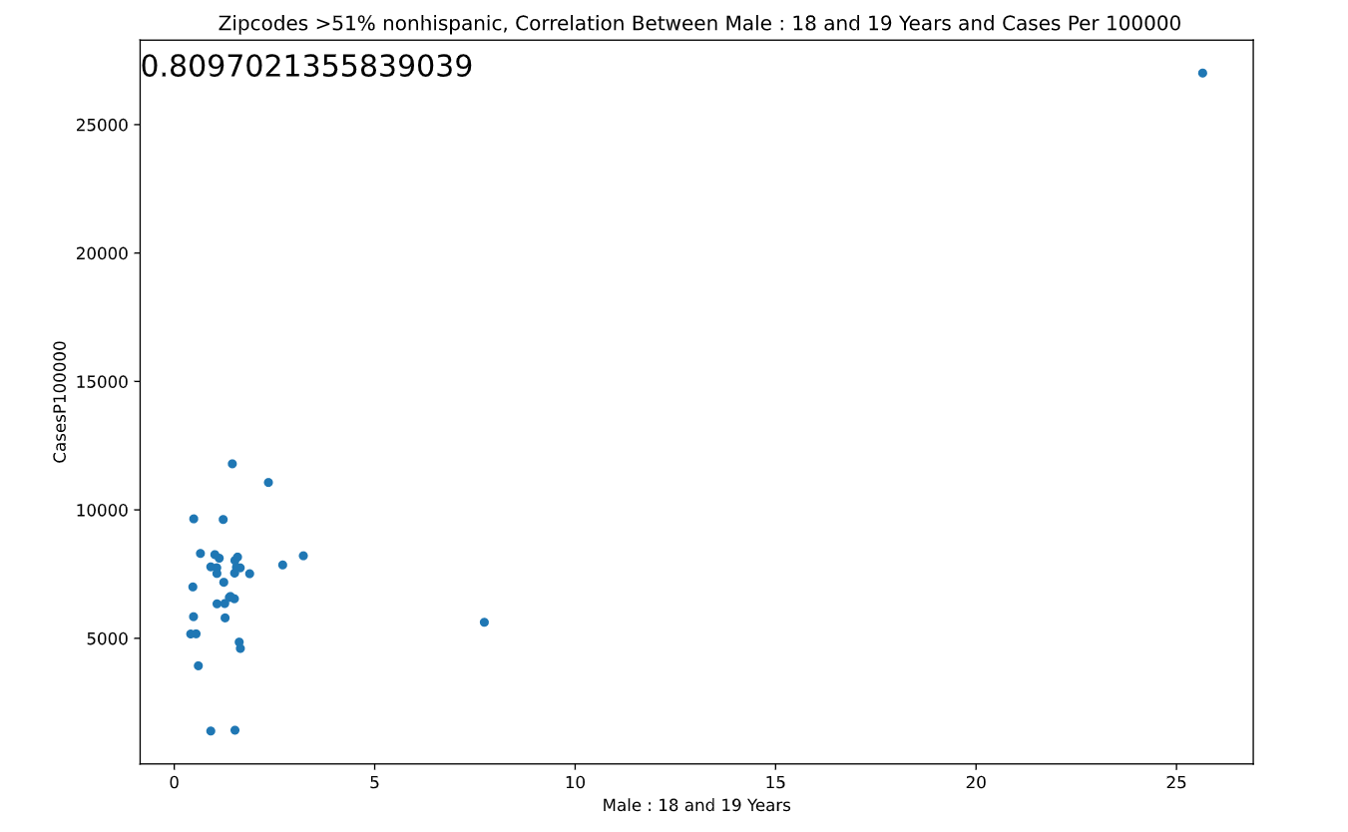
Non-Hispanic Males 18 and 19 Years Old

Slide 6
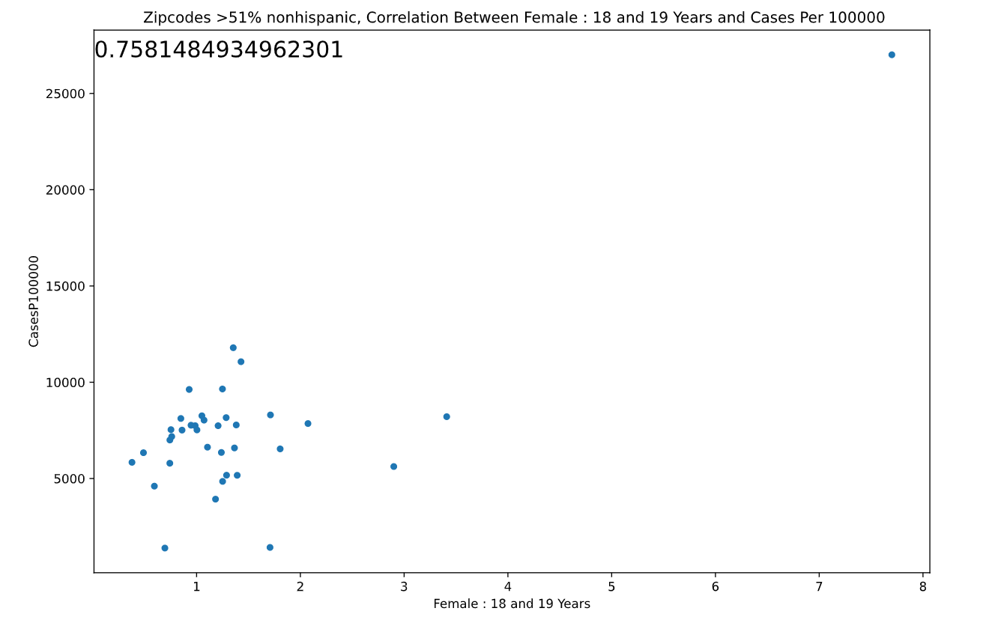
Non-Hispanic Females 18 and 19 Years Old

Slide 7
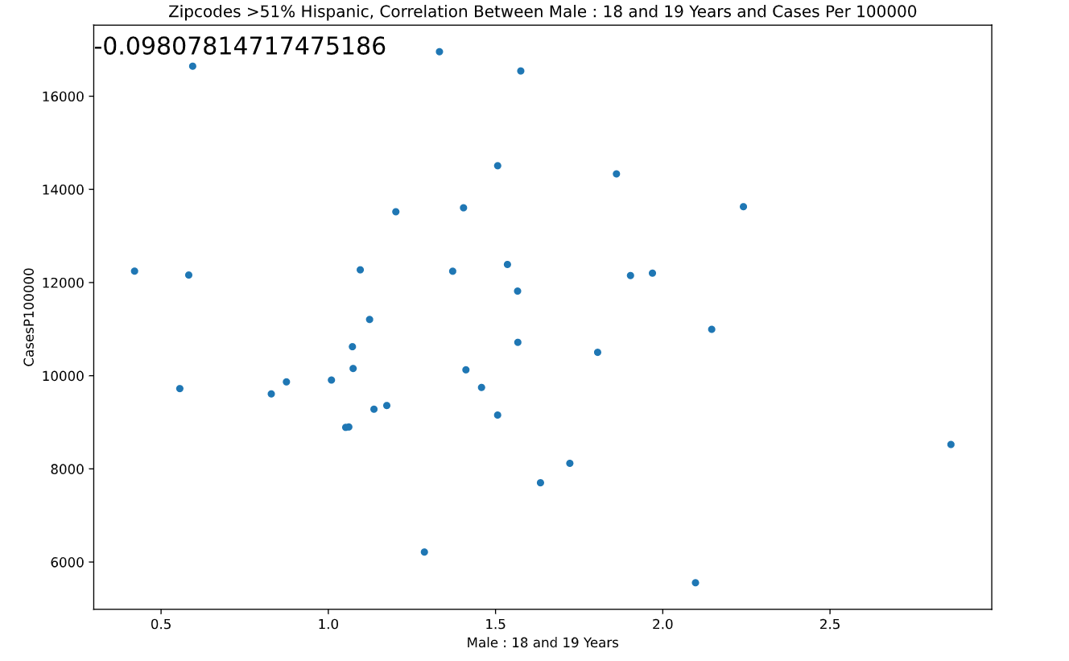
Hispanic Males 18 and 19 Years Old

Slide 8
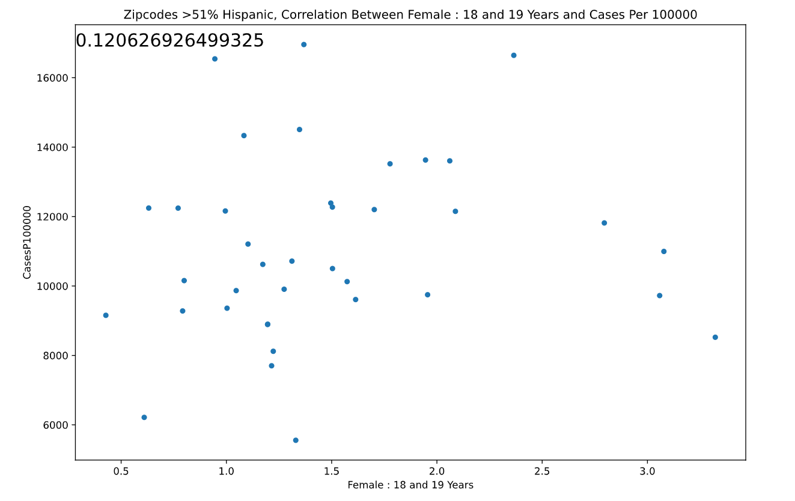
Hispanic Females 18 and 19 Years Old

Slide 9
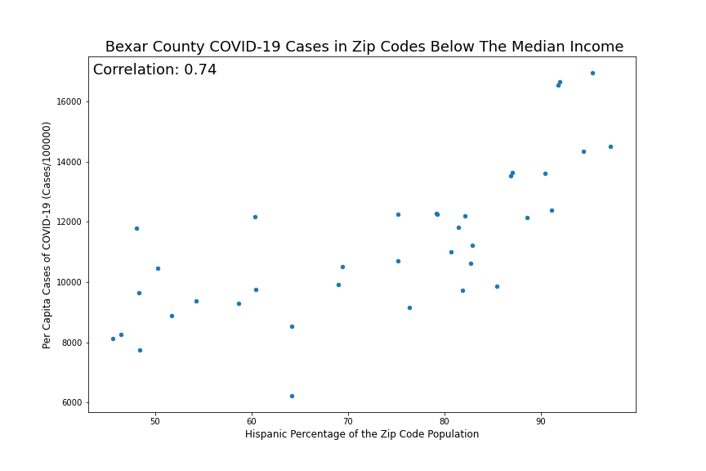
Zip codes with below median incomes

Slide 10
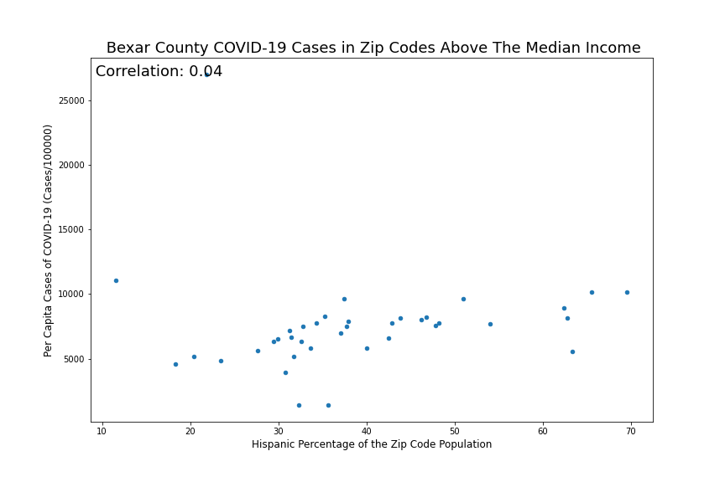
Zip codes with above median incomes

Slide 11
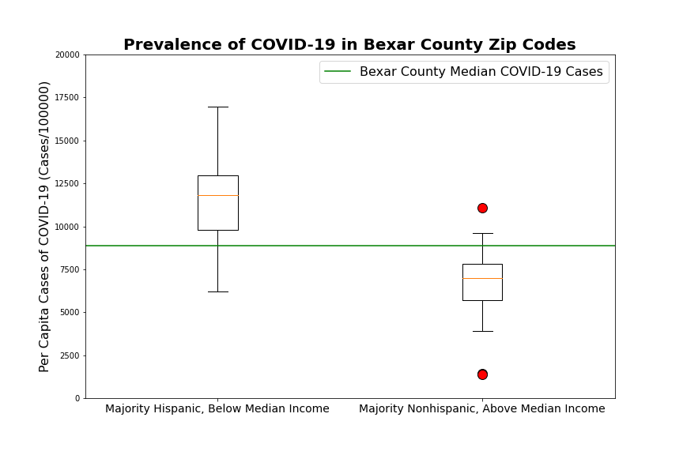
Income and ethnicity create discrepancies in observed cases of COVID19.

Slide 12
Future Explorations
Complete the same analysis for demographics in other Metro Areas.
Search for more data on majority hispanic, low income zip codes.
Look at factors such as multigenerational homes, commute time, essential employee status, and unemployment.

Slide 13
Questions

